Slide 1
SMART DOOR LOCK SYSTEM USING ARDUINO
TEAM MEMBERS :
KOLANU RAVITEJA (160722747008)
MD FAISAL HUSSAIN (160722747009)
URE SANATH KUMAR (160722747052)

Slide 2
TABLE OF CONTENTS
INTRODUCTION
LIST OF COMPONENTS USED
ROLE OF EACH COMPONENT
CIRCUIT DIAGRAM OF THE DEVICE
SOURCE CODE
OUTPUT OF THE PROJECT
CONCLUSION

Slide 3
INTRODUCTION
In a world where connectivity is key, this project is a testament to the endless possibilities of integrating technology seamlessly into our homes. Our project isn't just about automation; it's about redefining security at the most fundamental level – the entrance to our homes. The RFID Door Lock System combines cutting-edge RFID technology with a servo motor-driven lock mechanism, ensuring both convenience and robust security.

Slide 4
LIST OF COMPONENTS USED
RFID CARD READER (RC522)
ARDUINO UNO
LCD DISPLAY
SERVO MOTOR
BUZZER
LOCK
CONNECTING WIRES
GALVANIZED IRON WIRE

Slide 5
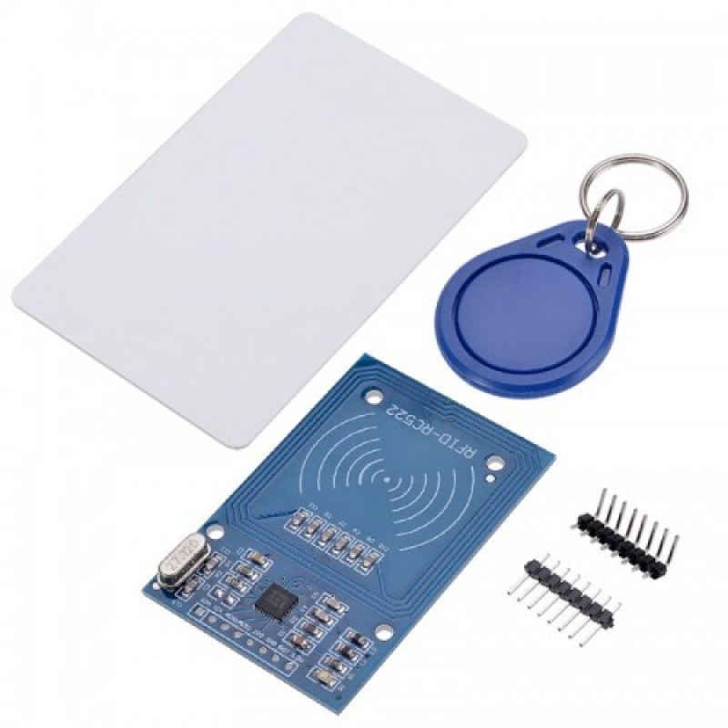
RFID CARD READER ( RC522 )
Radio-Frequency Identification (RFID) is a technology that uses radio waves to wirelessly transmit data between an RFID reader and a tag attached to an object. In our smart home device, RFID serves as a key component for secure access control.
Role in Our Project:
User Authentication: The RFID module is integral to user identification, ensuring that only authorized individuals can access specific areas or functionalities within the smart home system.
Contactless Access: Unlike traditional methods, RFID provides a contactless means of access, adding both convenience and a touch of sophistication to our home automation.

Slide 6
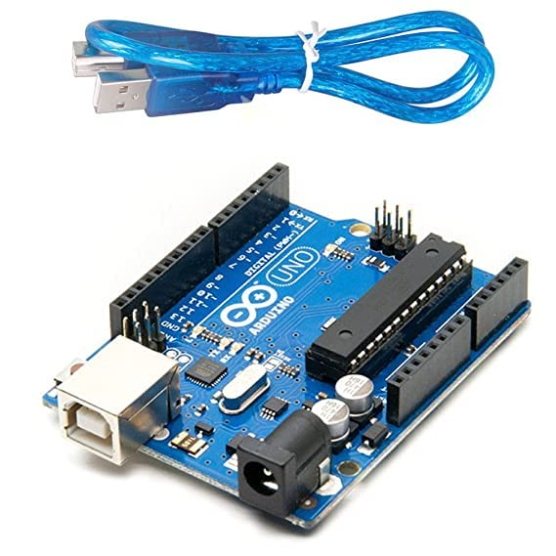
ARDUINO UNO
Arduino Uno is a popular microcontroller board based on the ATmega328P microcontroller. It provides various digital and analog input/output pins for interfacing with other electronic components, runs at a clock speed of 16 MHz, allowing for relatively fast processing of tasks, set of digital input/output pins (14 of which can be used as PWM outputs) and analog input pins (6 in total), USB connection, power supply, etc.
Arduino Uno is versatile and suitable for a wide range of applications, from simple blinking LED projects to more complex applications like robotics, home automation, and IoT projects.

Slide 7
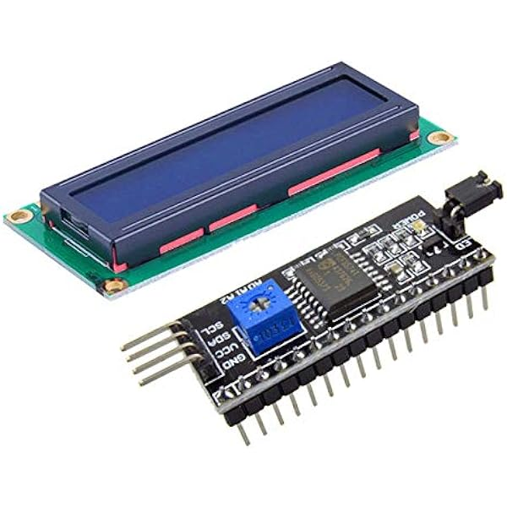
LCD DISPLAY WITH I2C MODULE
An LCD (Liquid Crystal Display) is a type of flat-panel display technology that uses liquid crystals to modulate light and produce images. In the context of your smart home project, the LCD display serves as a user interface, providing visual feedback and information. Here are some key aspects of the LCD display in your project:
The I2C module is a small additional board that is attached to the back of a standard parallel LCD.
It converts the parallel data and control signals of the LCD into the I2C protocol. This backpack often includes a small chip (like PCF8574) to handle the conversion and an I2C interface.

Slide 8
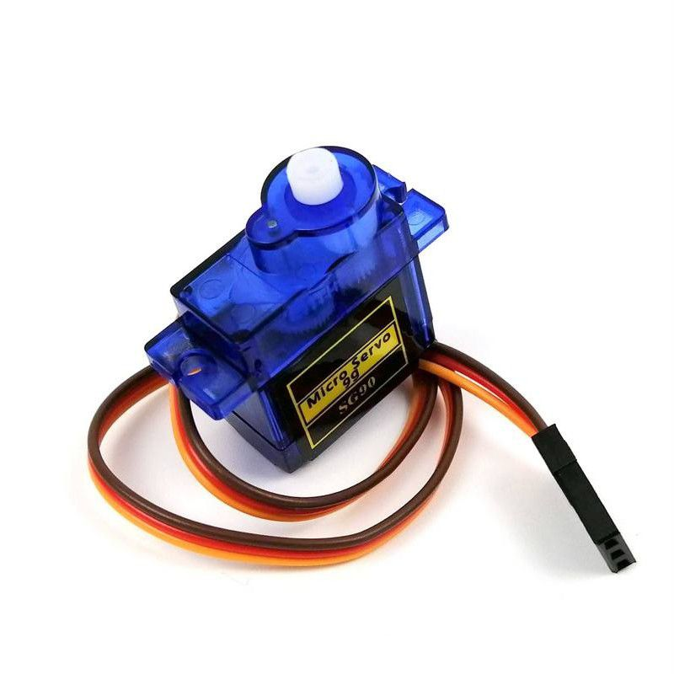
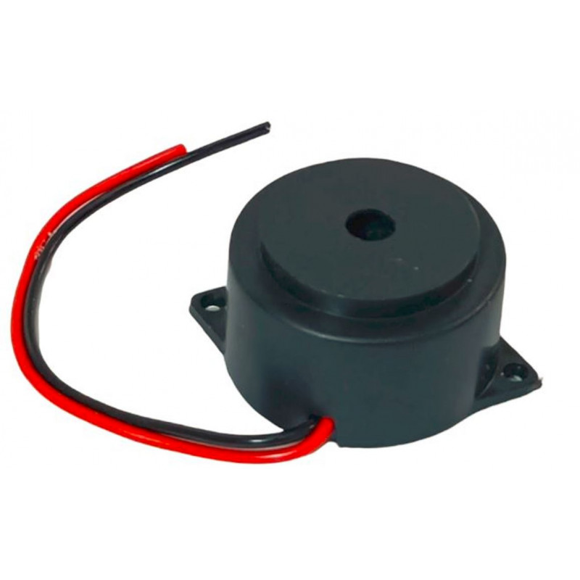
SERVO MOTOR
The servo motor is a commonly used component in Arduino projects, including your smart home device. A servo motor is a rotary actuator that allows precise control of angular position. It's often used in projects where you need to move something to a specific angle or position, such as in robotics, automation, or in your case, a door lock system.
BUZZER
A buzzer is an audio signaling device that produces sound when an electrical signal is applied to it.
The buzzer can be used for various purposes, such as indicating successful access, alerting about a system event, or notifying users of an error condition.

Slide 9
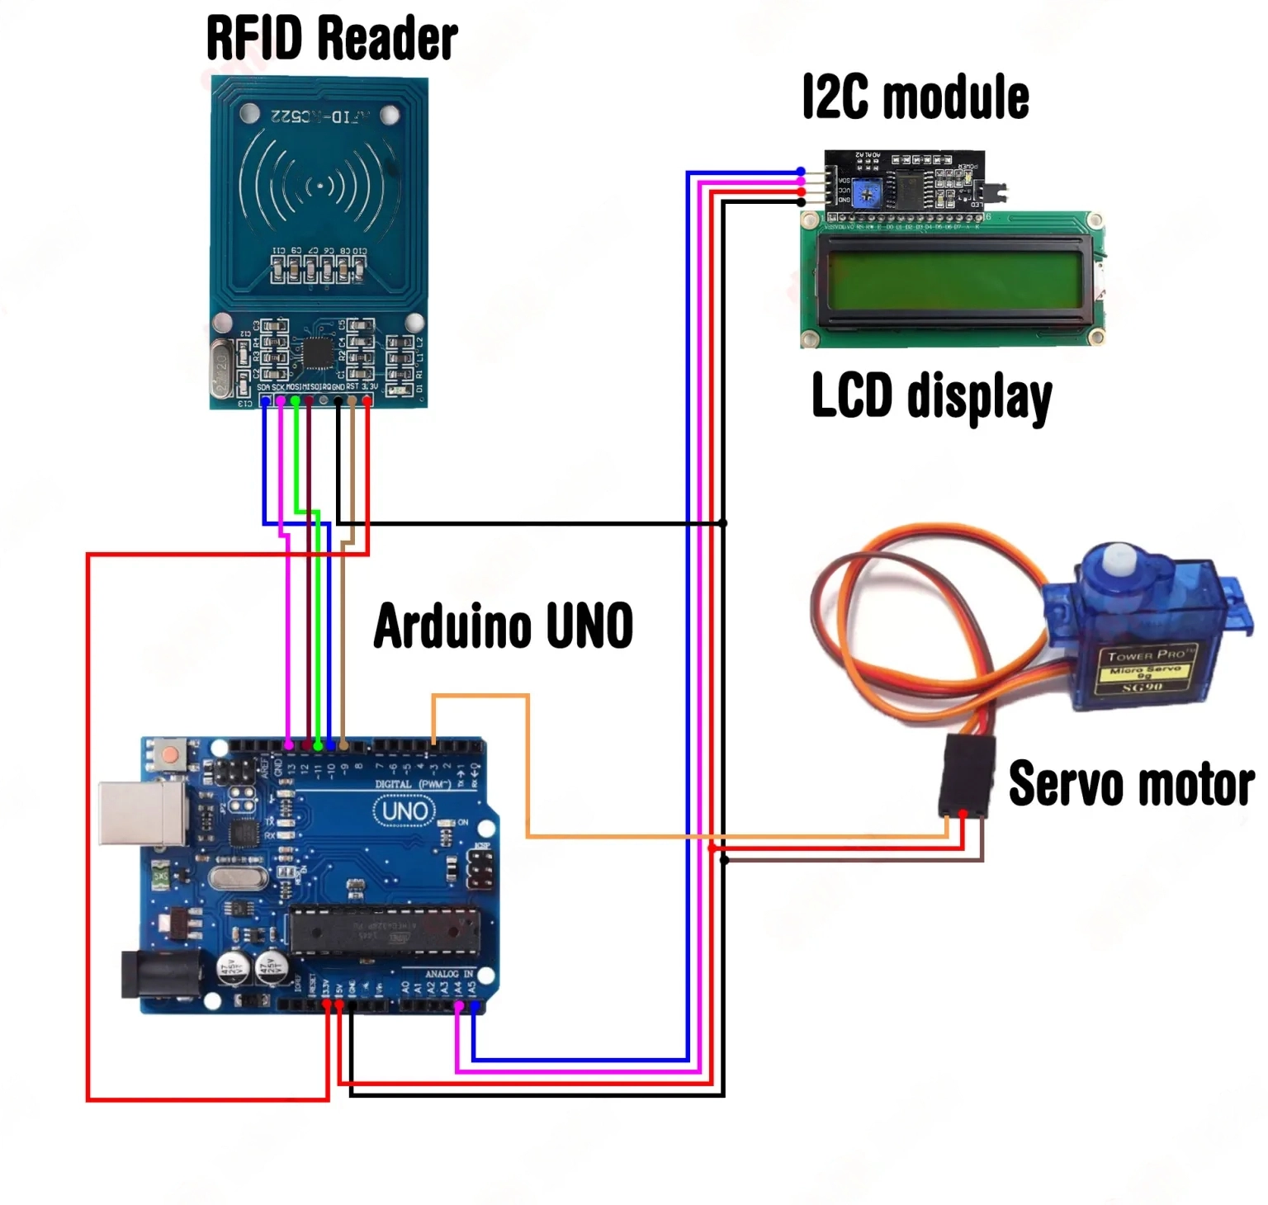
CIRCUIT DIAGRAM

Slide 10
SOURCE CODE
#include <Servo.h>
#include <LiquidCrystal_I2C.h>
#include <SPI.h>
#include <MFRC522.h>
#define SS_PIN 10
#define RST_PIN 9
#define BUZZER_PIN 7 pin for the buzzer
// Replace these with your actual UIDs
String UID1 = "633191F5";
String UID2 = "224C8E55";
String UID3 = "43B65B50";
byte lock = 0;
Servo servo;
LiquidCrystal_I2C lcd(0x27, 16, 2);
MFRC522 rfid(SS_PIN, RST_PIN);
void setup() {
Serial.begin(9600);
servo.write(70);
lcd.init();
lcd.backlight();
servo.attach(3);
SPI.begin();
rfid.PCD_Init();
pinMode(BUZZER_PIN, OUTPUT);
}
void beep(int frequency, int duration) {
tone(BUZZER_PIN, frequency, duration);
delay(duration);
noTone(BUZZER_PIN);
delay(50); // Small delay to separate beeps
}

Slide 11
void kiliKiliSound() {
beep(1000, 200); // kili
delay(50);
beep(1500, 200); // kili
delay(50);
beep(2000, 200); // kili
}
void byeByeSound() {
beep(2000, 200); // bye
delay(50);
beep(1500, 200); // bye
delay(50);
beep(1000, 200); // bye
}
void loop() {
lcd.setCursor(4, 0);
lcd.print("Welcome!");
lcd.setCursor(1, 1);
lcd.print("Put your card");
SOURCE CODE
if (!rfid.PICC_IsNewCardPresent()) return;
if (!rfid.PICC_ReadCardSerial()) return;
lcd.clear();
lcd.setCursor(0, 0);
lcd.print("Scanning");
Serial.print("NUID tag is: ");
String scannedUID = "";
for (byte i = 0; i < rfid.uid.size; i++) {
lcd.print(".");
scannedUID.concat(String(rfid.uid.uidByte[i] < 0x10 ? "0" : ""));
scannedUID.concat(String(rfid.uid.uidByte[i], HEX));
delay(300);
}
scannedUID.toUpperCase();
// Send UID and lock status over serial
Serial.print("UID:");
Serial.println(scannedUID);

Slide 12
SOURCE CODE
Serial.print("Status:");
Serial.println(lock == 1 ? "Locked" : "Unlocked");
if ((scannedUID == UID1 || scannedUID == UID2 || scannedUID == UID3) && lock == 0) {
servo.write(70);
lcd.clear();
lcd.setCursor(0, 0);
lcd.print("Door is locked");
kiliKiliSound(); // kili kili kili sound when the door is locked
delay(1500);
lcd.clear();
lock = 1;
} else if ((scannedUID == UID1 || scannedUID == UID2 || scannedUID == UID3) && lock == 1) {
servo.write(160);
lcd.clear();
lcd.setCursor(0, 0);
lcd.print("Door is open");
byeByeSound(); // bye bye sound when the door is open
delay(1500);
lcd.clear();
lock = 0;
} else {
lcd.clear();
lcd.setCursor(0, 0);
lcd.print("Wrong card!");
beep(1500, 400); // Beep for the wrong card
delay(1500);
lcd.clear();
}
}

Slide 13
WORKING
RFID Card Detection:
User presents RFID card to the reader.
RFID module reads the card's unique identifier.
User Verification:
Arduino compares the card's identifier with authorized identifiers.
If authorized, proceed to next step; otherwise, trigger the buzzer for
unauthorized access.
Door Unlocking:
Upon successful verification, Arduino signals the servo motor to unlock the door.
Audio Feedback:
Buzzer provides audible feedback for access success or failure.
LCD Display:
Display status messages:
“Door is open" when the RFID card is authorized.
“Door is close" when the RFID card is not authorized.
“Wrong Card” when the RFID card ID is not valid.

Slide 14
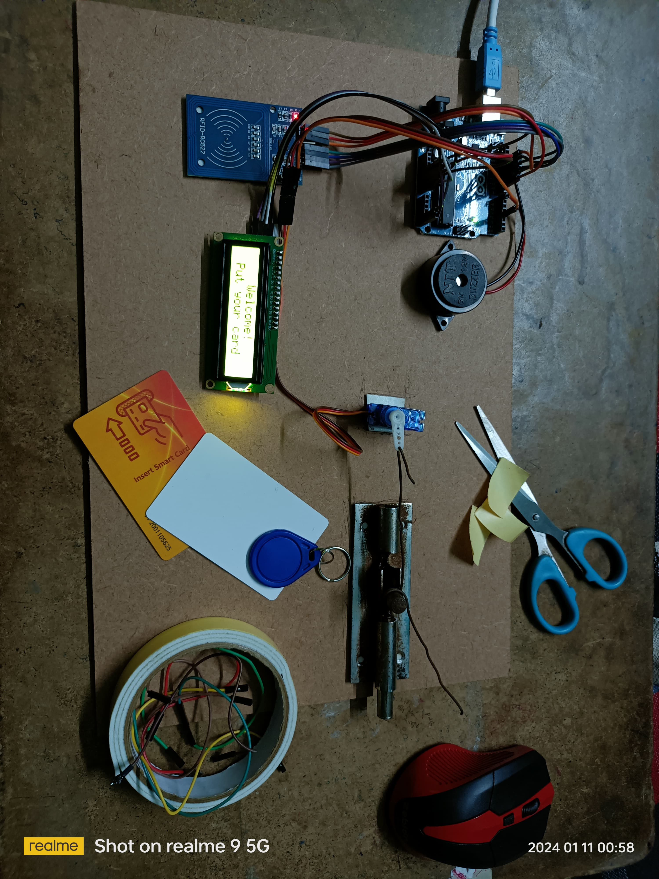
OUTPUT

Slide 15
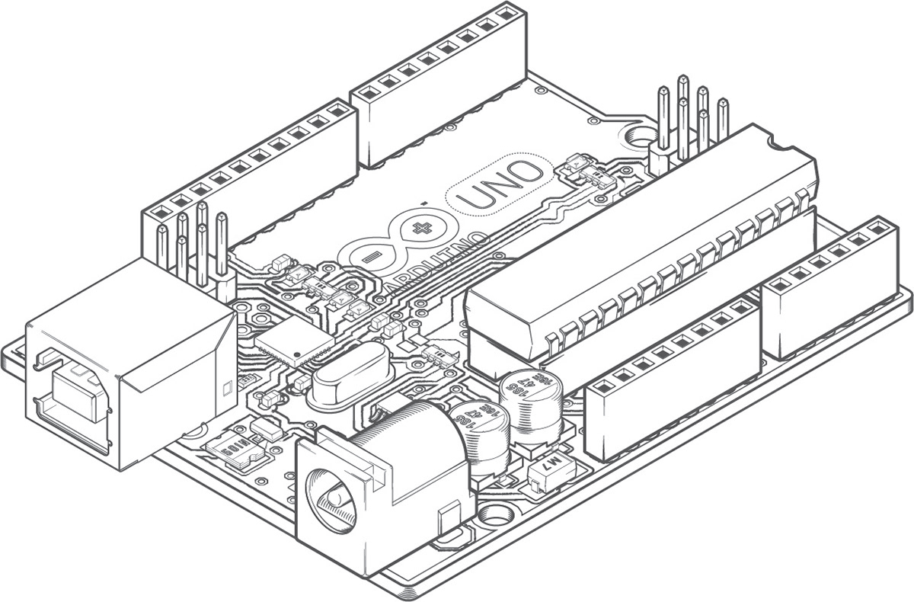
CONCLUSION
As we stand at the intersection of innovation and practicality, our project envisions a future where homes are not just automated but intelligently responsive to our needs
Our smart home project is not just a demonstration of technology but a glimpse into the possibilities that lie ahead.

Slide 16


